Slide 1
Comets as test cases for planetesimal-formation scenarios
Jürgen Blum Institut für Geophysik und extraterrestrische Physik Technische Universität Braunschweig Germany
In collaboration with
Bastian Gundlach, Horst Uwe Keller, Yuri Skorov

Slide 2
The “perfect” witness to the planetesimal-formation era
Contemporary to solar-nebula phase
Small in size
small/no hydrostatic compression
small/no thermal alteration
Stored far away from the Sun for the last 4.5 Gyr
small/no thermal and aqueous alterations
few/no impacts at rather low speeds (i.e., no collisional fragment)
Abundant and bright
Comet Hale-Bopp 1997; image credit ESO/E. Slawik

Slide 3
How can we reveal the secret of their formation?
Formation Model
?
Thermophysical Model
Observations

Slide 4
Planetesimal/cometesimal-formation models
Gravitational Instability
Mass Transfer
Fluffy Ice Growth⁶
Dust/ice grains
↓
Formation of cm-sized dust aggregates by sticking collisions¹
↓
Bouncing barrier¹
↓
Spatial concentration by Kelvin-Helmholtz Instability
OR
magneto-rotational Instability
↓
Further concentration by streaming Instability²
↓
Gravitational Instability³
↓
Fragmentation of collapsing cloud
↓
Planetesimals
Dust/ice grains
↓
Formation of cm-sized dust aggregates by sticking collisions¹
↓
Bouncing barrier¹
↓
“Maxwell-tail” aggregates penetrate bouncing barrier⁵
↓
Fragmentation events among large aggregates (produce small aggregates) AND Mass transfer in collisions between small and large aggregates⁴
↓
“Lucky survivors” grow⁵
↓
Planetesimals
Ice grains (0.1 µm)
↓
Fractal hit-and-stick growth to cm-sized aggregates
↓
Hit-and-stick growth with self and gas compression to 100 m-sized aggregates
↓
Hit-and-stick growth with self-gravity compression to km-sized aggregates
↓
Planetesimals
References:
¹ Zsom et al. 2010
² Youdin & Goodman 2005
³ Johansen et al. 2007
⁴ Wurm et al. 2005
⁵ Windmark et al. 2012; Garaud et al. 2013
⁶ Kataoka et al. 2013

Slide 5
Planetesimal/cometesimal-formation models
Gravitational Instability
Mass Transfer
Fluffy Ice Growth
1 µm
1 µm
0.1 µm
1 cm
1 cm
1-10 km
10 km
1 km

Slide 6
Planetesimal/cometesimal-formation models
Gravitational Instability
Mass Transfer
Fluffy Ice Growth
Consequences
cm-sized agglomerates collapse under mutual gravity at virial speed and do not fragment¹.
Due to the non-destructive formation process, objects possess three fundamental size scales (µm, cm, km)
The typical tensile strength for small objects is ~1 Pa.
Due to gravity, the collapsing agglomerates will form an RCP structure leading to a porosity of ~80%.
Consequences
Planetesimals form at typically 50 m/s impact velocity.
Planetesimals should be rather homogeneous (no intermediate size scale).
The typical tensile strength for small objects is ~1 kPa.
The porosity of the planetesimals is ~60%.
Consequences
Model works only for 0.1 µm ice (or ice-coated) grains. For larger monomer grains, planetesimals cannot form.
The porosity of the final planetesimals is ~90%.
Internal structures and tensile strength have not been analyzed yet. If the bodies are homogeneous, then the tensile strength is ~ 1kPa.
Reference: ¹ Wahlberg Jansson & Johanson 2014

Slide 7
How can we reveal the secret of their formation?
Formation Model
?
Thermophysical Model
Observations

Slide 8
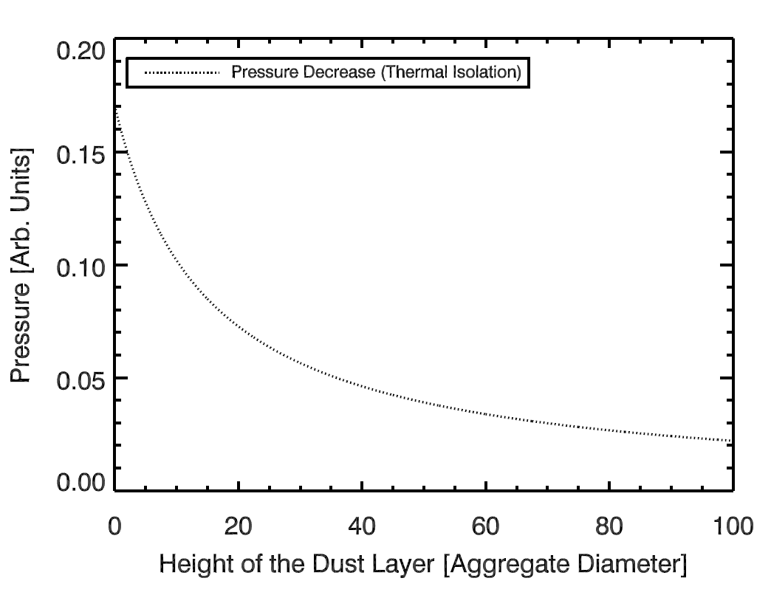
Thermophysical model of comet activity
Water-vapor pressure at ice surface as a function of thickness of dust layer
Transport of absorbed solar energy
ice-free dust layer
pressure at the dust-ice interface is proportional to the available energy flux to the dust-ice interface
pristine dust-ice mixture

Slide 9
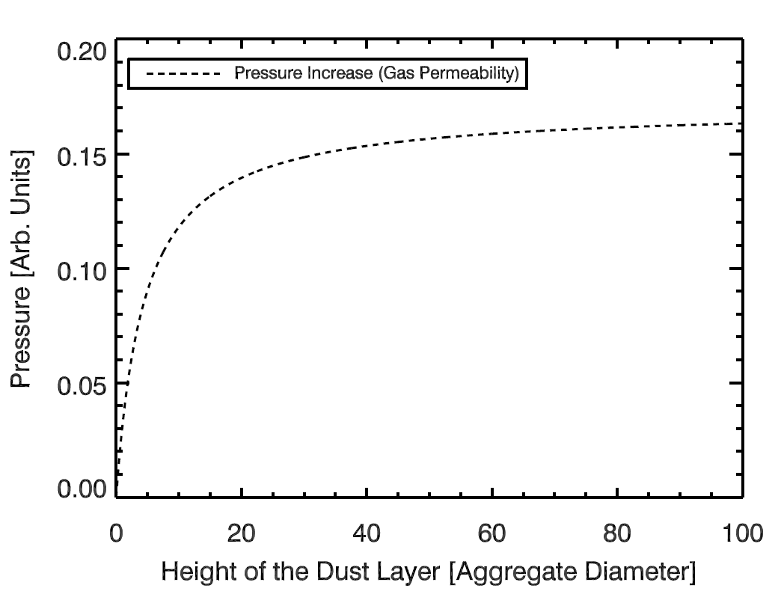
Thermophysical model of comet activity
Water-vapor pressure at ice surface as a function of thickness of dust layer
Transport of sublimed water molecules
ice-free dust layer
pressure at the dust-ice interface is a function of the resistivity of the dust layer against gas transport to the surface
pristine dust-ice mixture

Slide 10
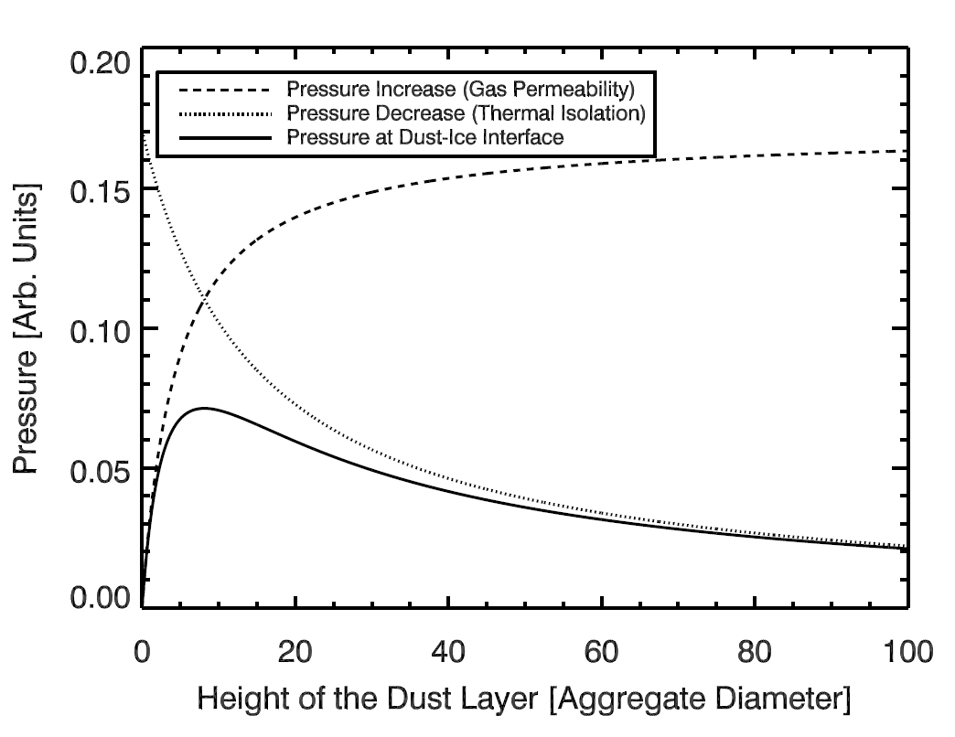
Thermophysical model of comet activity
Water-vapor pressure at ice surface as a function of thickness of dust layer
Energy and mass transport
ice-free dust layer
resulting pressure at the dust-ice interface
pristine dust-ice mixture

Slide 11
Thermophysical model of comet activity
Physical model for dust activity
Energy and mass transport
ice-free dust layer
resulting pressure at the dust-ice interface
pristine dust-ice mixture
pressure > tensile strength → activity
pressure < tensile strength → no activity

Slide 12
Thermophysical model of comet activity
Estimate of maximum achievable gas pressure at dust-ice interface
Energy and mass transport
Assumptions
Distance to Sun: $r$
Total incoming solar energy is consumed by water-ice evaporation
Gas permeability of dust layer is low
Temperature at dust-ice interface: 230 K
Latent heat of water-ice evaporation: 2500 J/g
↓
Maximum achievable gas pressure
$$p_{\text{max}}≈{0.3 \text{Pa} \left(\frac{r}{\text{1 }\text{AU}}\right)}^{−2}$$
ice-free dust layer
pristine dust-ice mixture

Slide 13
Planetesimal/cometesimal-formation models
Gravitational Instability
Mass Transfer
Fluffy Ice Growth
Consequences
cm-sized agglomerates collapse under mutual gravity at virial speed and do not fragment.
Due to the non-destructive formation process, objects possess three fundamental size scales (µm, cm, km)
The typical tensile strength for small objects is ~1 Pa.
Due to gravity, the collapsing agglomerates will form an RCP structure leading to a porosity of ~80%.
Consequences
Planetesimals form at typically 50 m/s impact velocity.
Planetesimals should be rather homogeneous (no intermediate size scale).
The typical tensile strength for small objects is ~1 kPa.
The porosity of the planetesimals is ~60%.
Consequences
Model works only for 0.1 µm ice (or ice-coated) grains. For larger monomer grains, planetesimals cannot form.
The porosity of the final planetesimals is ~90%.
Internal structures and tensile strength have not been analyzed yet. If the bodies are homogeneous, then the tensile strength is ~ 1kPa.

Slide 14
Thermophysical model of comet activity
The tensile strength of gravitational collapsing dust aggregates
Dust/ice grains
↓
Formation of cm-sized dust aggregates by sticking collisions
↓
Bouncing barrier
↓
Spatial concentration by Kelvin-Helmholtz Instability
OR
magneto-rotational Instability
↓
Further concentration by streaming Instability
↓
Gravitational Instability
↓
Fragmentation of collapsing cloud
↓
Planetesimals
1 µm
Properties of cm-sized dust aggregates
Radius: s ~ 0.5 cm
Porosity: ~60%
Tensile strength: ~1 kPa
Properties of cometesimals
Collapse occurs at virial speed (~ 1 m/s)
Most aggregates remain intact
Cometesimals are loosely bound by inter-aggregate van der Waals forces with tensile strengths of $T≈$ $0.6 \text{Pa} {\left(\frac{s}{\text{1 }\text{mm}}\right)}^{−2/3}$ (Skorov & Blum 2012)
1 cm
1-10 km

Slide 15
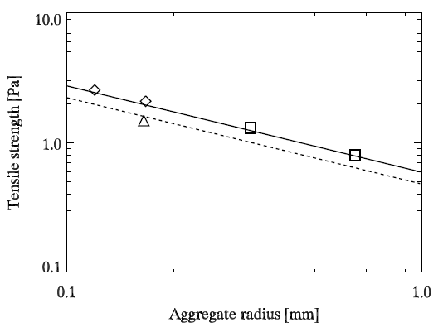
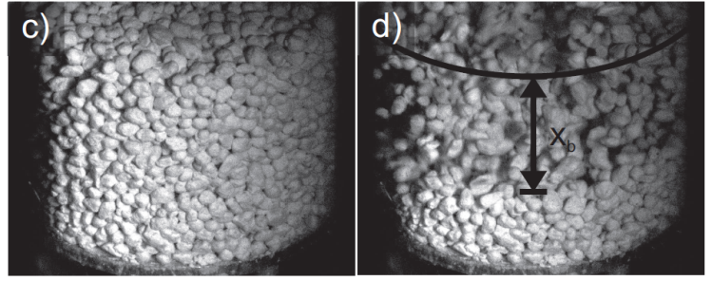
Thermophysical model of comet activity
The tensile strength of gravitational collapsing dust aggregates
- model confirmation by laboratory experiments
Brisset et al. (subm.)
Blum et al. 2014
p_{max} @ 0.5 AU
φ_{p} = 0.37
$T≈$ $0.6 \text{Pa} {\left(\frac{s}{\text{1 }\text{mm}}\right)}^{−2/3}$
p_{max} @ 1 AU
(Skorov & Blum 2012)
p_{max} @ 2 AU

Slide 16
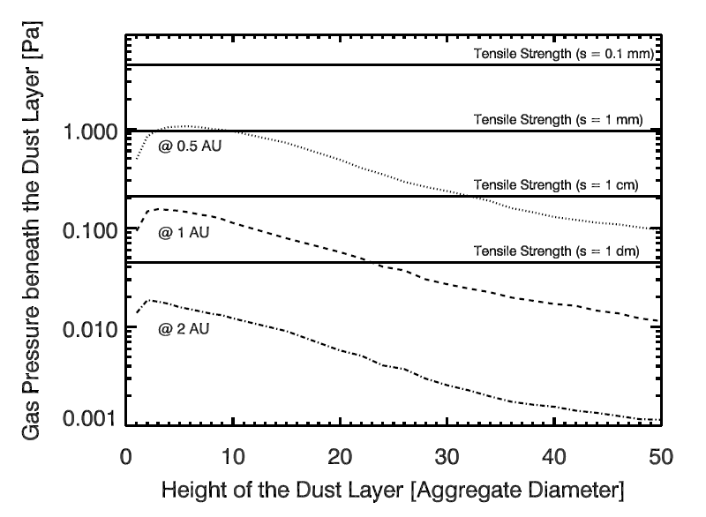
Thermophysical model of comet activity
Putting it all together…

Slide 17
How can we reveal the secret of their formation?
Formation Model
?
Thermophysical Model
Observations

Slide 18
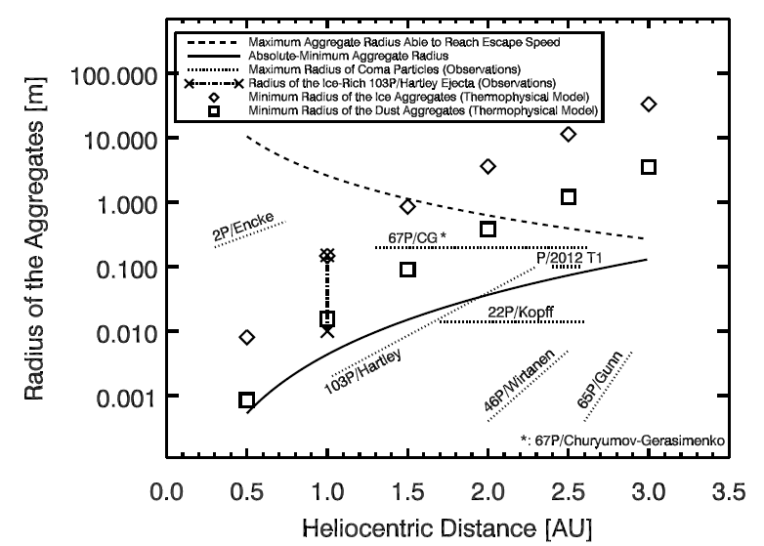
Observations of dust-aggregate sizes
Comparison between model predictions and observations
Other volatiles than H₂O (e.g., CO or CO₂) required!

Slide 19
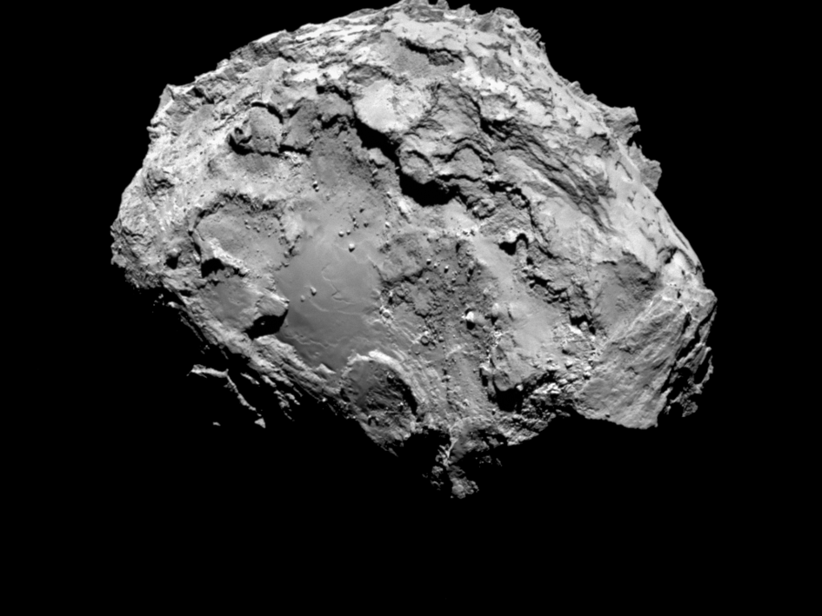
Conclusions
Cometesimals form in a three-stage process:
coagulation of dust and ice into cm-sized aggregates,
spatial concentration of aggregates by streaming instability,
gravitational instability due to collective mass attraction.
This model can explain the formation AND present activity of comets.
Comet activity is RECURRENT as long as energy supply is sufficiently large.
High-velocity impacts locally “PASSIVATE” comet surface.
…Rosetta will show whether or not this model is correct and will further constrain future model approaches…
…stay tuned…

