Slide 1
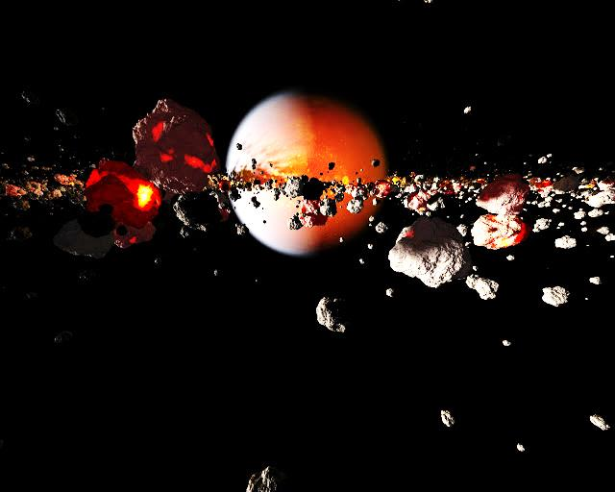
The outcome of dust aggregate collisions in streaming and gravitational instabilities
Mohtashim Bukhari & Jürgen Blum
Planet Formation and Evolution 2014
9. September 2014, Kiel

Slide 2
Outline
1- Motivation
Problem of cm-size bouncing barrier
2- Streaming instability, a possible solution
Gravitational collapse induced by streaming instability
3- The lab setup
Experimenal procedure
4- Experiments and results
Collision outcomes
The release mechanism
5- Conclusion
Conclusion
Comparison with model
The collision spectrum of mass ratio
The accelerators
The fragmentation strength µ

Slide 3
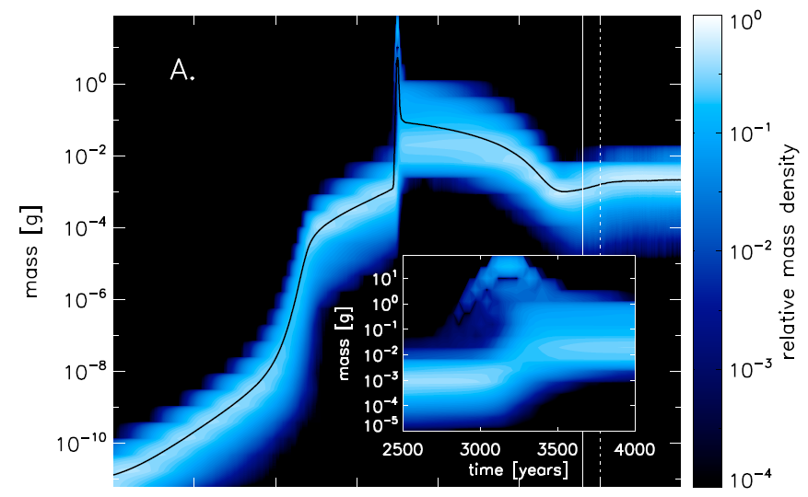
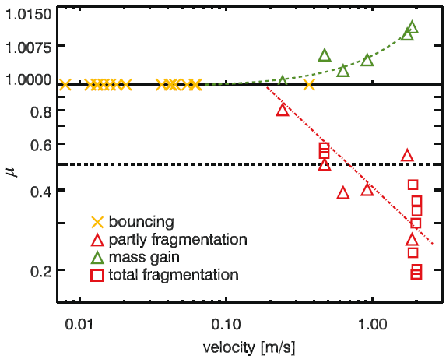
1- Motivation: problem of cm-size bouncing barrier
Direct formation of km-sized planetesimals impossible due to “bouncing barrier”
Bouncing in lab Bouncing in simulation
Collision outcome between 2 cm spheres
The slowest impact velocity where fragmen-tation occurred was at 24 cm/s
Beitz et al 2011a
Maximum dust-aggregate size at 1 AU:
~1 cm (Zsom et al. 2010)

Slide 4
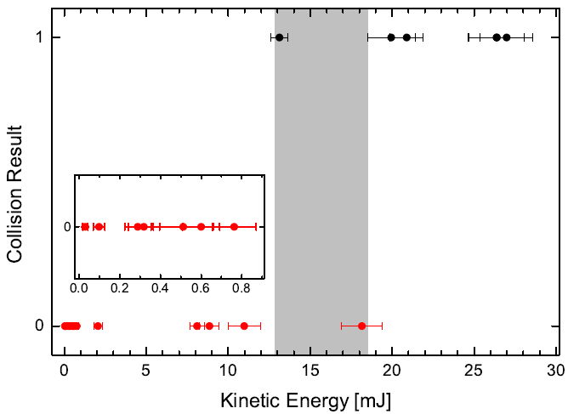
1- Motivation: problem of cm-size bouncing barrier
Direct formation of km-sized planetesimals impossible due to “bouncing barrier”
Bouncing in lab Bouncing in simulation
Decker & Tieser 2013
1 : fragmentation
0 : bouncing
collision of two
same size (12 cm)
aggregates
Maximum dust-aggregate size at 1 AU:
~1 cm (Zsom et al. 2010)

Slide 5
2- Streaming instability, a possible solution

Slide 6
2- Streaming instabilitiy, a possible solution to form planetesimals
Streaming Instability
The velocity difference between gas and solids also triggers streaming instabilities. The resulting turbulence halts particle sedimentation and can lead to clumping.
ν_{kep} (1-η)
Azimuthal
velocity
F_{G}
F_{P}
Radial drift

Slide 7
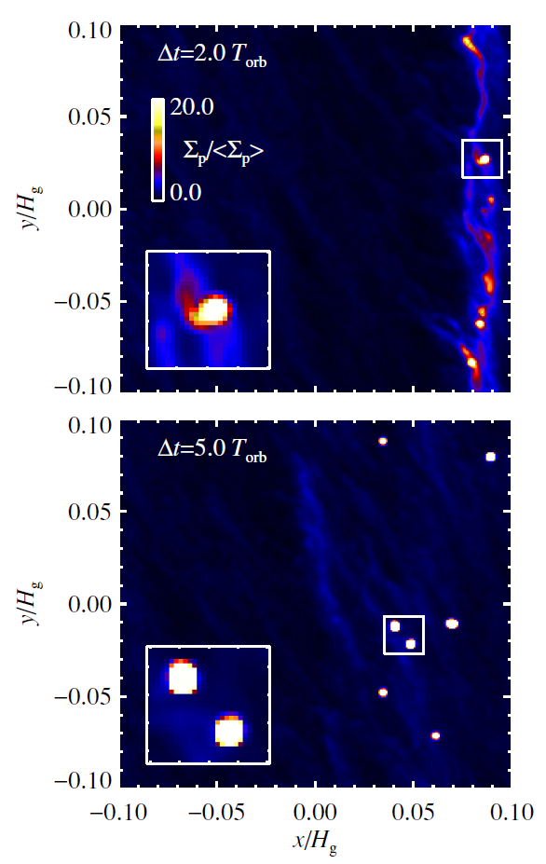
2- Streaming instabilitiy, a possible solution to form planetesimals
Gravitational Instability
The common element invoked by various GI models is the final stage of gravitational collapse when the gravitationally bound pebbles and boulders are brought together, collide, and eventually accrete into large objects.
Nesvorny et al: 2010
↓
After five orbits approximately 20% of the solid mass is in seven bound clusters, each containing a mass equivalent to a 100–200 km scale solid body.
Johansen et al. 2009
For the experimental understanding of SI
see poster PF-3 by Capelo

Slide 8
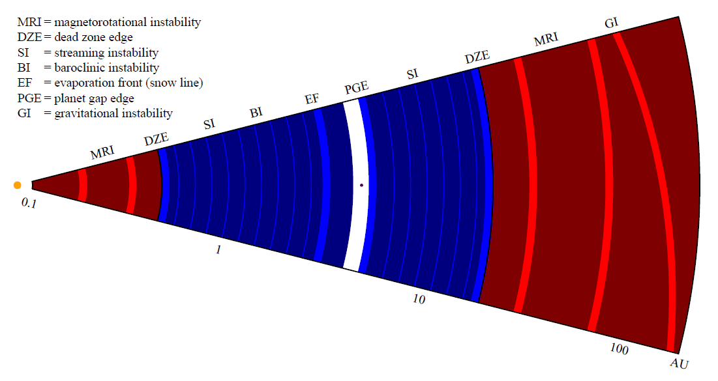
2- Streaming instabilitiy, a possible solution to form planetesimals
this work
Johansen et al. 2014

Slide 9
3- The lab setup

Slide 10
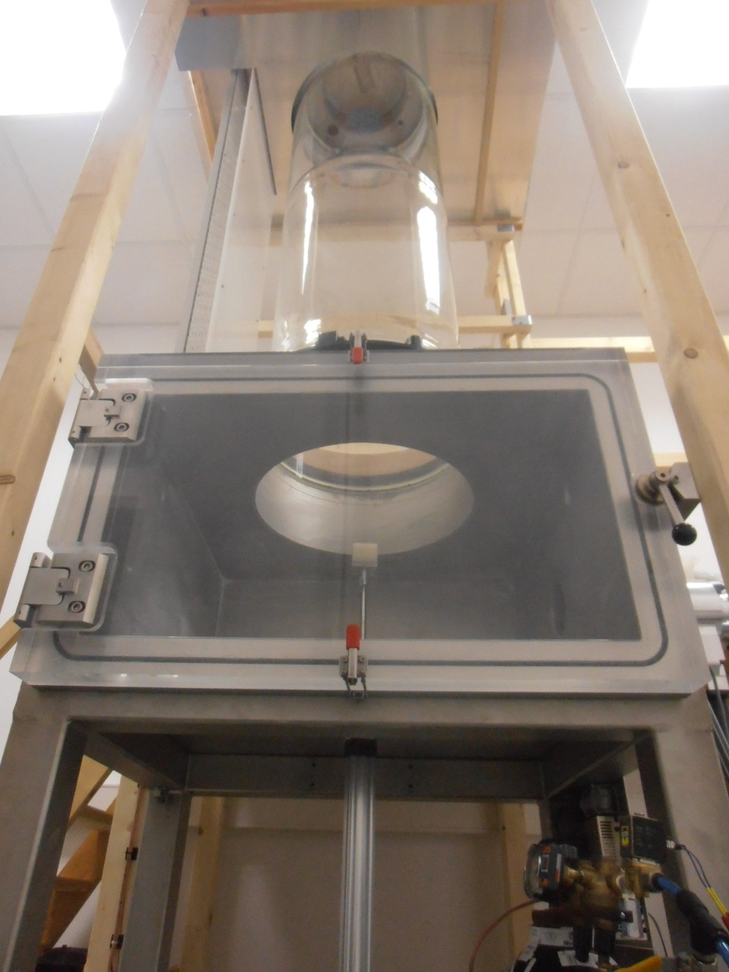
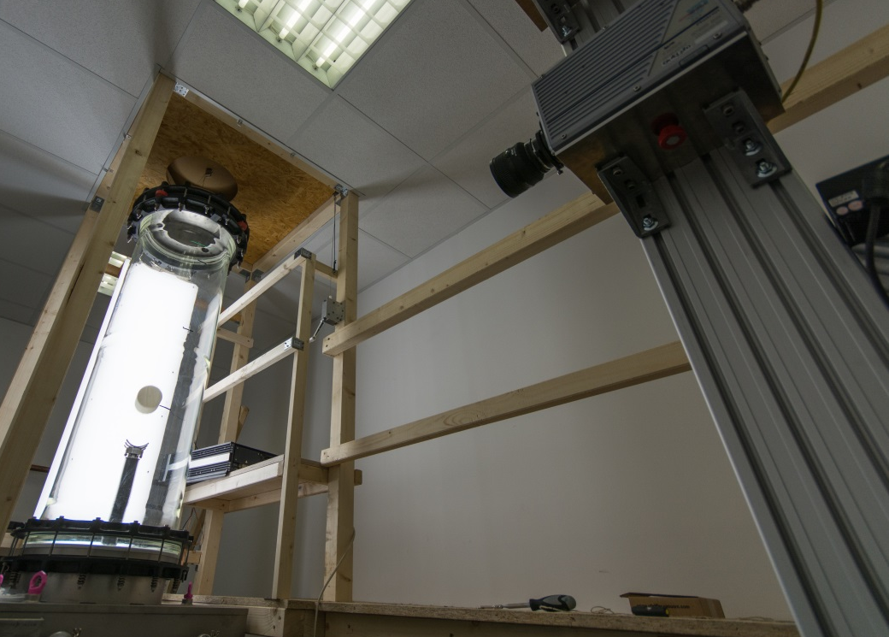
3- The lab setup
7
4
3
8
2
5cm
5
1
1- Vacuum chamber (~10⁻³ mbar)
2- Glass vacuum cylinder
3- LED panels
4- Release mechanism
5- 5-cm sample analog
6- Pneumatic accelerator
7- High-speed camera
8- Camera stand
6

Slide 11
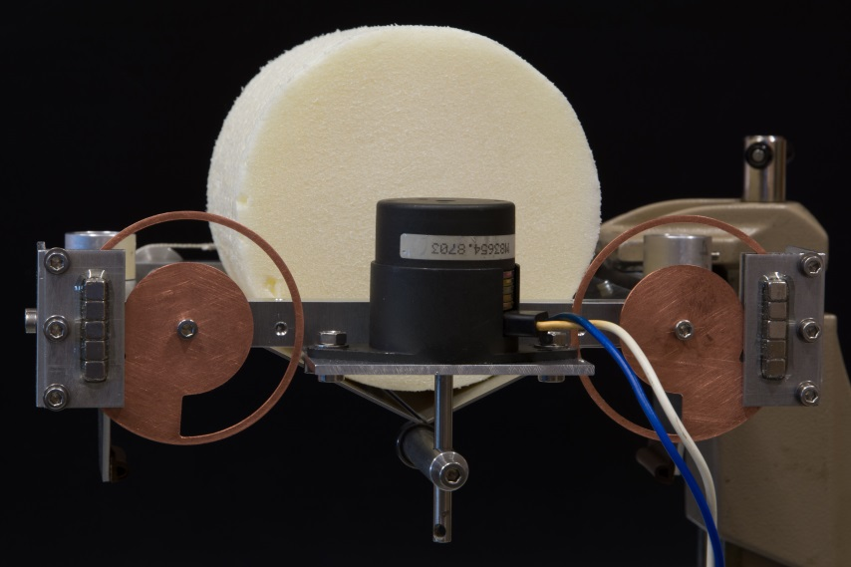
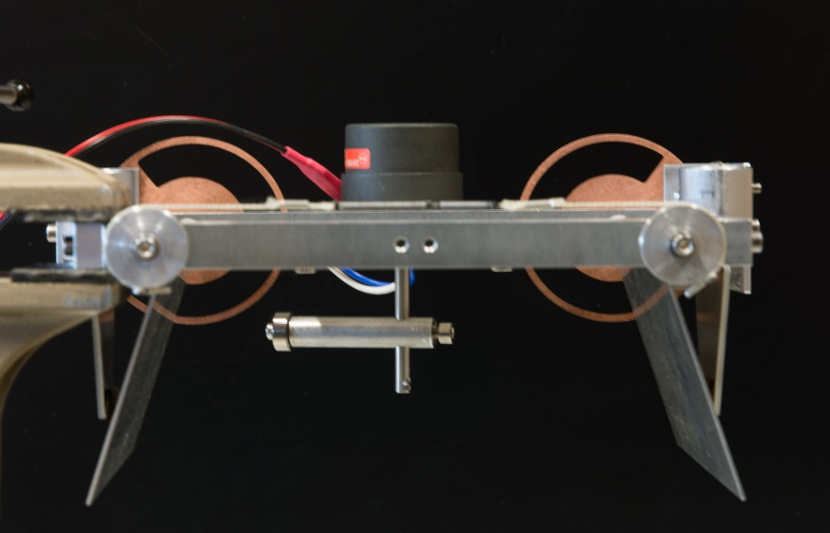
3- The lab setup: release mechanism
Double-wing trap-door release mechanism
1
5
2
4
3
5
2
1- 10-cm sample analog
2- Eddi-current brakes
3- 90° rotatable lock
4- Wing trap-doors
5- Solenoid magnet
3
4

Slide 12
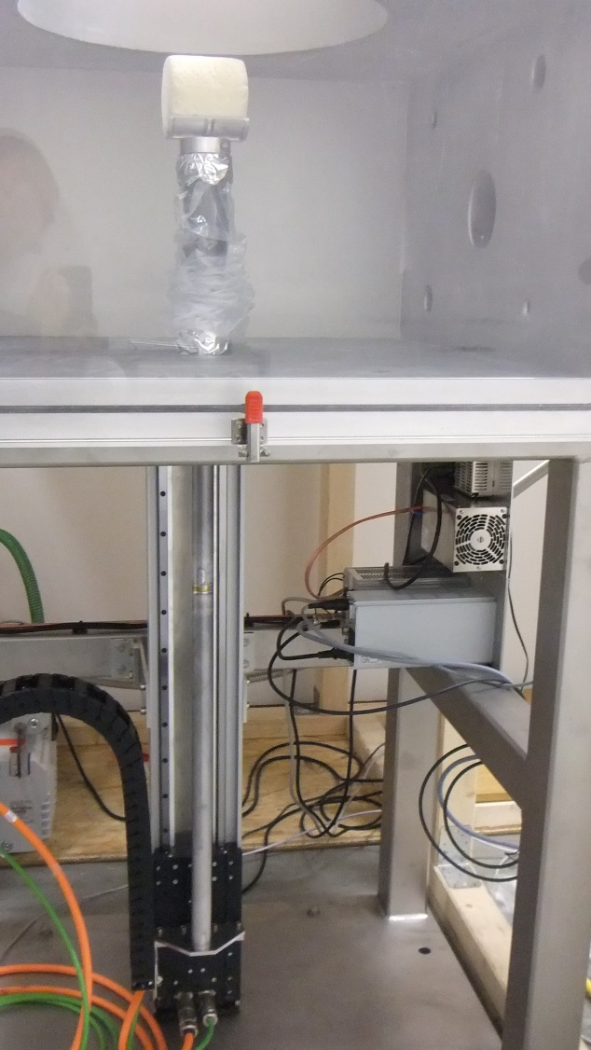
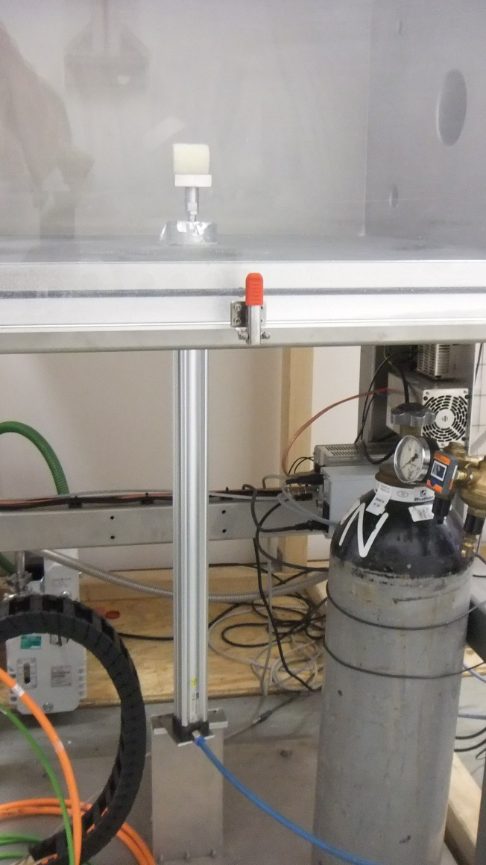
3- The lab setup: accelerators
Electromagnetic Accelerator
Spring-based Accelerator
Pneumatic Accelerator

Slide 13
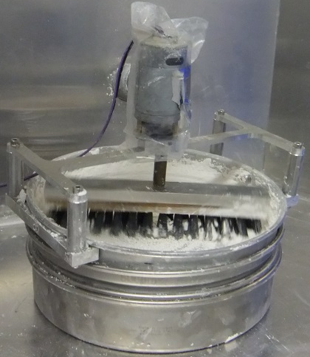
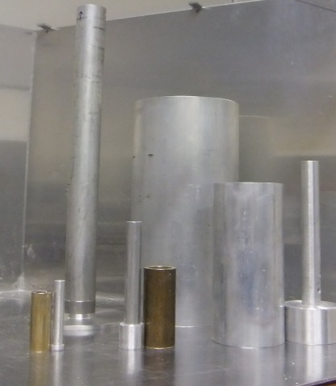
3- The lab setup: experimental procedure
10 cm
1 cm 2 cm 5 cm
Step 1- sifting through 500 µm mesh
Step 2- weighing the dust for desired porosity
Step 3- dust-aggregate formation by using the moulds of the respective size
1 cm 2 cm 5 cm 10 cm
Samples with 65% porosity ready for loading

Slide 14
4- Experiments and Results

Slide 15
4- Experiments and results: outcome of collisions
Fragmentation Growth Growth
Dust-aggregate sizes: 5 cm – 5 cm
Impact velocity: 4.2 m/s
Dust-aggregate sizes: 5 cm – 2 cm
Impact velocity: 4.3 m/s
Dust-aggregate sizes: 1 cm – 5 cm
Impact velocity: 4.6 m/s

Slide 16
4- Experiments and results: the fragmentation strength µ
$$µ= \frac{m_{f}}{m_{i}}$$
$m_{i}$: initial mass of the target$m_{f}$: mass of the largest fragment of the target
µ$\left\{\begin{matrix}>1 \\ <1\end{matrix} \begin{matrix}mass gain \\ fragmentation\end{matrix}\right.$

Slide 17
4- Experiments and results: collision spectrum of mass ratio
For the velocity above 1 m/s
$f= \frac{m_{p}}{m_{t}}$ $=$ $\frac{projectile mass}{target mass}$
f$\left\{ \begin{matrix}≤0.1 \\ ≥0.1\end{matrix} \begin{matrix}mass gain \\ fragmentation\end{matrix}\right.$

Slide 18
4- Experiments and results: collision spectrum of mass ratio
Hill funtion
$$µ(x)=A+\left(B−A\right)\frac{E^{n}}{k^{n}+E^{n}}$$
A = start
B = end
k = Michaelis constant
$k= µ_{0.5}$
n = Hill coefficient

Slide 19
4- Experiments and results: collision spectrum of mass ratio

Slide 20
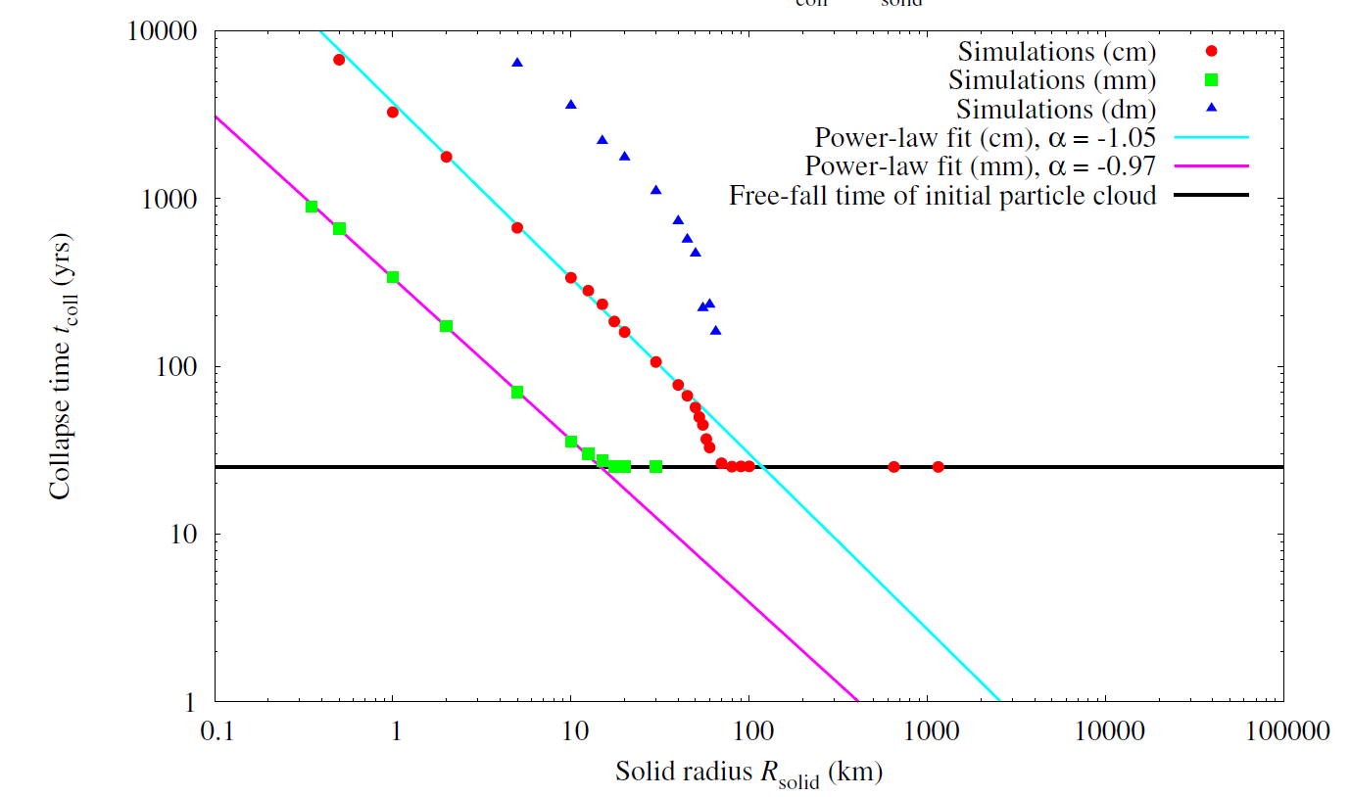
4- Experiments and results: comparison with model
For the swarms of given Hill radii and mass, it is the
size of pebbles which determines the collapse time.
$t_{ff}$ = 25,1 yrs
Wahlberg Jansson & Johansen 2014 (A & A, accepted)

Slide 21
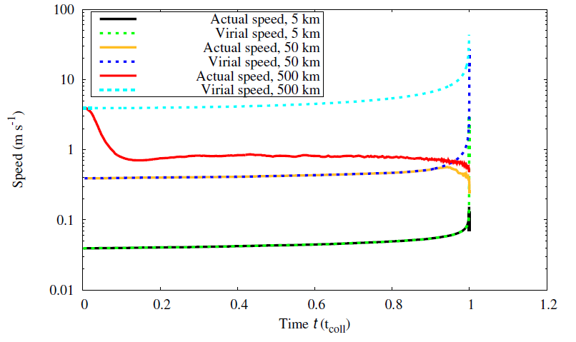
4- Experiments and results: comparison with model
frag. with mass transfer
Result bigger planetesimal
free fall collapse
Swarm of : cm size
Velocity : ~ 1 – 4 m/s
Swarm of : cm size
Velocity : < 1 m/s
bouncing
Result smaller planetesimal
longer collapse time
Wahlberg Jansson & Johansen 2014 (A & A, accepted)

Slide 22
5- Conclusion

Slide 23
5- Conclusion
Unequal cm-sizes (1-4 m/s) are likely to lead the planetesimal formation
Dust-aggregate sizes: 5 cm – 2 cm
Impact velocity: 4.3 m/s
Dust-aggregate sizes: 1 cm – 5 cm
Impact velocity: 4.6 m/s

Slide 24
The end
Thanks for your attention!
questions
&
criticism are welcome
Acknowledgment
This work is supported by DFG through SFB 963 “Astrophysical Flow Instabilities and Turbulence“. We thank Anders Johansen and Hubert Klahr for fruitful discussions.

