Slide 1
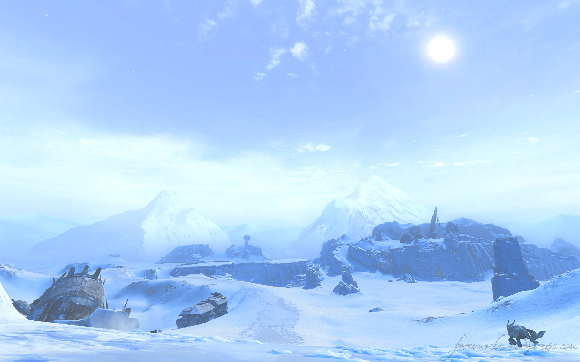

Grain Growth and the Role of Ices
Planet Formation and Evolution 2014, Kiel University, September 8 – 10, 2014
Jens Teiser
Iceplanet Hoth, Star Wars,
The Empire Strikes Back
Faculty of Physics, University Duisburg-Essen
jens.teiser@uni-due.de

Slide 2
DISCLAIMER!!
References in this talk are not complete!
Authors of important work might and will remain unmentioned in this talk. This is not lack of respect or a matter of taste, but a matter of time...

Slide 3
Coagulation as Starter for Planet Formation
Grains condense from the gas phase (µm sizes)
Astronomers observe larger particles
Coagulation takes place
For gravitational instabilities:
  Concentrating mechanism is needed
  Works only for particles larger than the first grains (decimeter)

Slide 4
Relative Velocities
relative
velocities
(cm/s)
Weidenschilling
& Cuzzi 1993

Slide 5

Grain Growth - Silicates
Dusty Work

Slide 6
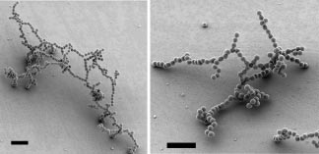
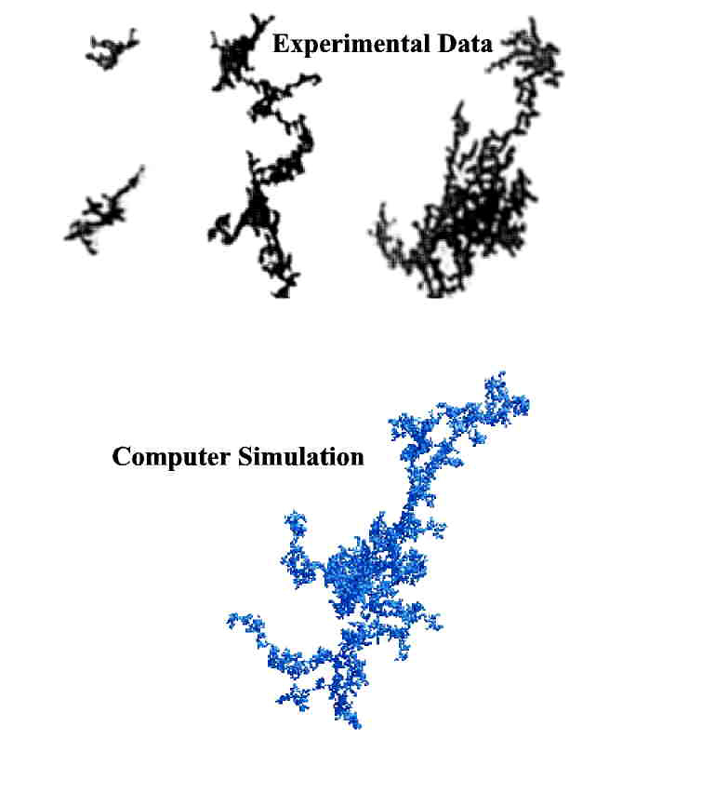
Grain Growth - Silicates
1 µm – 1 mm
Ballistic Particle-Cluster-
Aggregation
Ballistic Cluster-Cluster-
Aggregation
Well understood in
experiments and models
Blum 2000
Wurm &
Blum 2000
Theoretical studies: Meakin et al. 1989, Ossenkopf 1993, Henning & Sablotny 1995, Sablotny 1996, Dominik and Tielens 1997, Paszun & Dominik 2006, Wada et al. 2007, ...
Laboratory experiments: Wurm 1997, Wurm & Blum 1998, Heim 1999, Nübold et al. 2001, Wurm & Blum 2000, Blum et al. 2002, Krause & Blum 2004, ...
Sablotny 1996

Slide 7
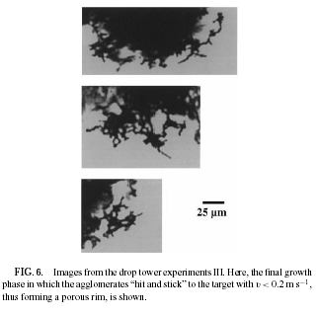
Grain Growth - Silicates
100 µm – 1 mm
10⁻³ – 0.5 m/s
Hit and stick
Compaction to non-
fractal particles
(Blum and Wurm 2000)
Paszun & Dominik, published in Blum & Wurm 2008

Slide 8
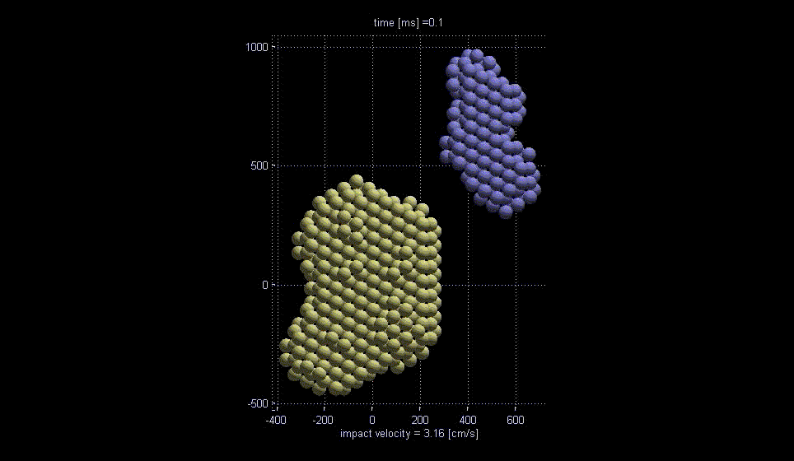
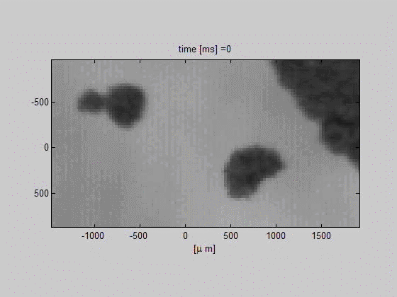
Grain Growth - Silicates
Compact agglomerates
Scale 1:1
R = 30µm
Vf_1 = 74%
Vf_2 = 74%
Result:
Bouncing
Jankowski et al. 2012
Many other studies:
Kothe et al. 2010, Weidling,...
Güttler et al. 2010

Slide 9
Grain Growth - Silicates
Mass transfer: part of the projectile sticks to target
Observed in several studies (Kothe et al. 2011, Beitz et al. 2011, Teiser et al. 2011...)
Meisner et al. 2013

Slide 10
Grain Growth - Silicates
Windmark
et al. 2012

Slide 11

Ice is sticky!
www.infokids.gr

Slide 12
Grain Growth - Ices
Dominik & Tielens 1997

Slide 13
Grain Growth - Ices
Silicates:
Paszun & Dominik, published in Blum & Wurm 2008
Ices:
Wada et al. 2009,
v = 70m/s

Slide 14
Grain Growth - Ices

Slide 15
Grain Growth - Ices

Slide 16
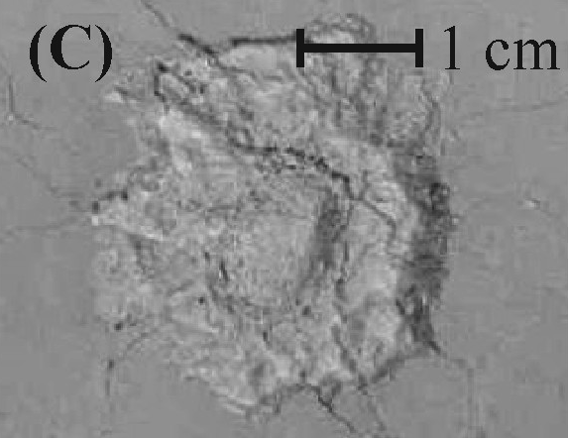
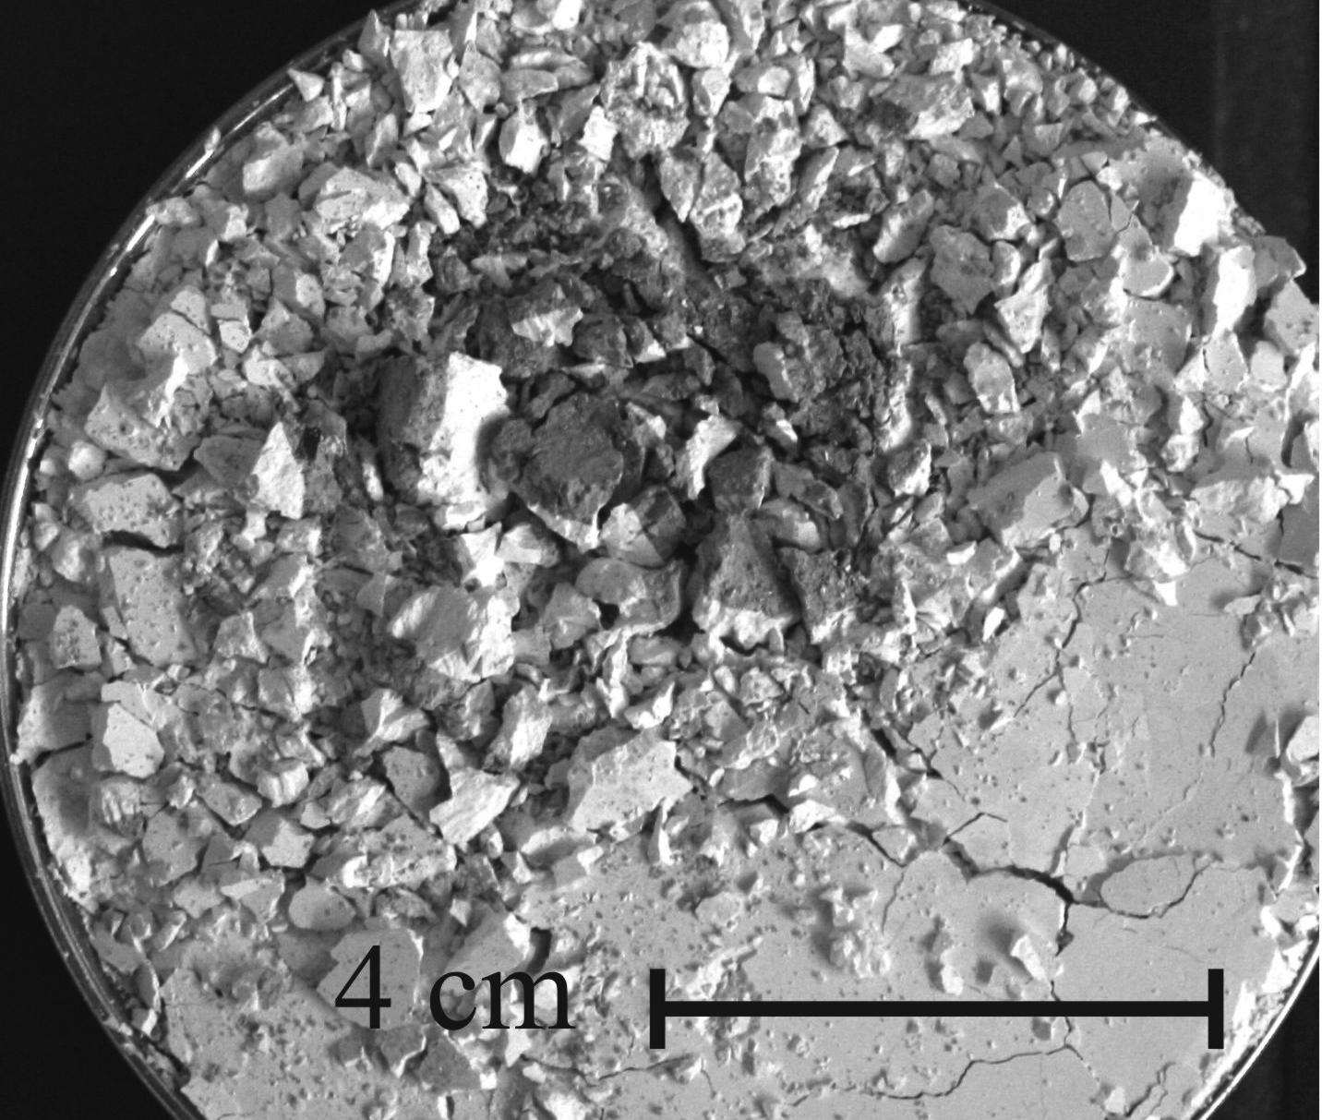
Grain Growth - Ices
Porous, sintered ice
D_{p} = 5 mm, 50 m/s
D_{p} = 7 mm, 100 m/s
Arakawa et al. 2011
Teiser & Wurm 2009

Slide 17
Grain Growth - Ices
Vff = 56 %
3.5 m/s
Vff = 30 %
3.2 m/s
Vff = 20 %
3.4 m/s
Vff = 48 %
V = 1 m/s
Beitz et al. 2011
Shimaki et al. 2012b

Slide 18
Grain Growth - Ices
Critical impact strength
Shimaki et al. 2012a

Slide 19
Grain Growth - Ices
Contact forces:
Rolling friction as
parameter for molecular
dynamics
Gundlach et al. 2011

Slide 20
Grain Growth - Ices
Twisting torque for ice grains
Aumatell & Wurm 2014

Slide 21
Grain Growth - Ices
Breaking up during sublimation generates small grains
Aumatell &
Wurm 2011
Local enhancement of particle density
Saito & Sirono
2011

Slide 22
Grain Growth - Ices
Sintering and evaporation generates small grains
relocation of water molecules
leads to grain growth
Sirono 2011

Slide 23
Grain Growth - Ices
Sintering and recondensation generates large grains close to the snowline
Ros &
Johansen
2013

Slide 24
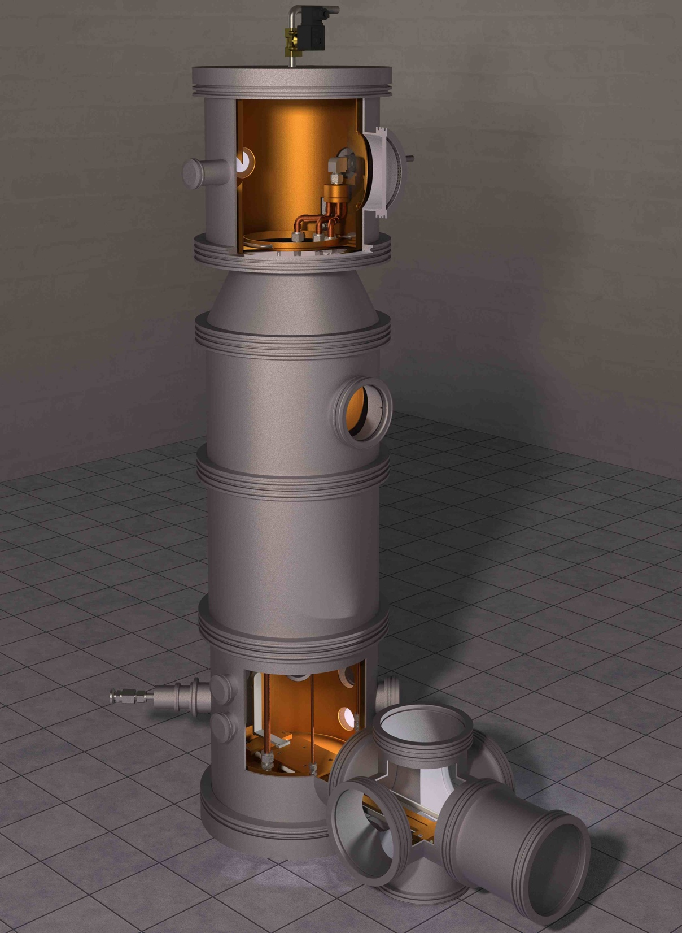
Grain Growth - Ices
Current work in
progress:
For silicates:
See posters by Kothe et al., Weidling et al., Deckers et al,...
For ices:
See posters by
Jankowski et al and Deckers et al.

Slide 25
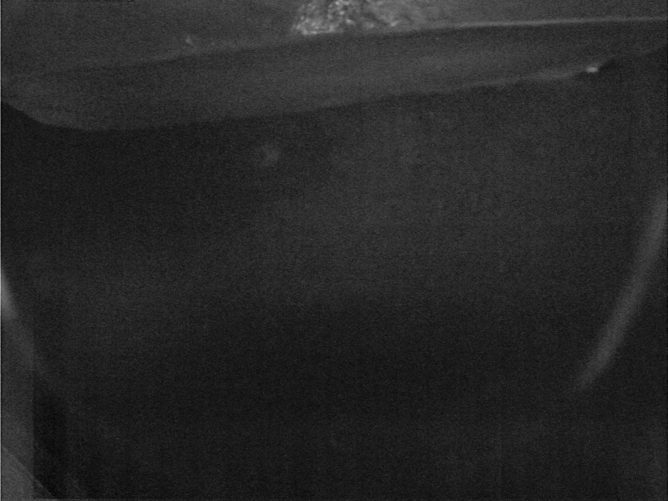
Grain Growth - Ices
Current work in progress: See poster by Johannes Deckers

Slide 26
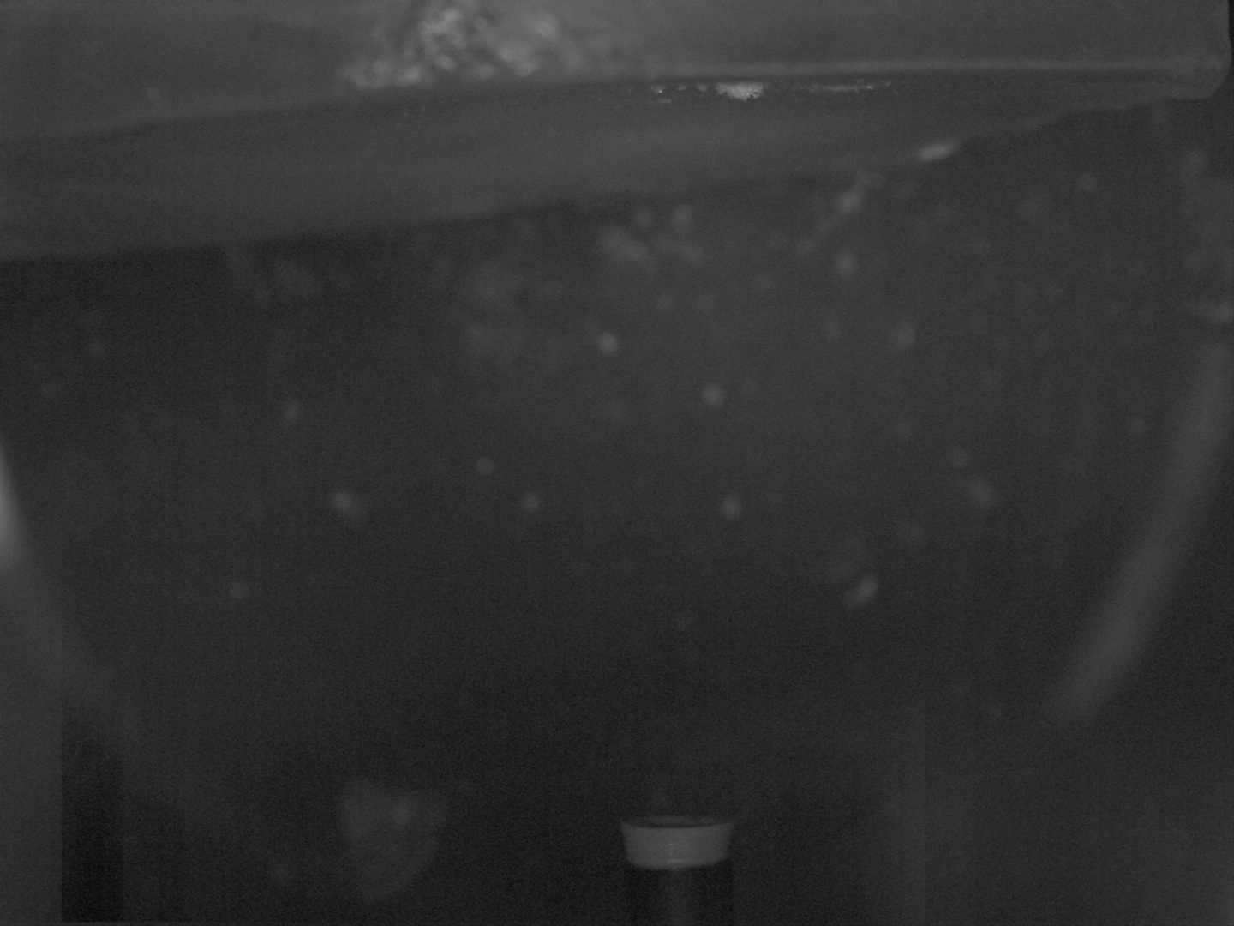
Grain Growth - Ices
Current work in progress: See poster by Johannes Deckers

Slide 27
Take Home Message
Silicates:
Big picture exists, work now is focussed on details
Ices:
Solid ice: Big picture exists, details are still in focus of work in progress
Small grains: Work has just started
Mechanical properties: First studies exist, but there is still a lot to do...

Slide 28

Take Home Message
„There is a theory which states that
if ever anyone discovers exactly what the Universe is for and why it is here,
it will instantly disappear and be replaced by something more bizarre and inexplicaple.
There is another theory which states that this has already happened.“
Douglas Adams

