Slide 1


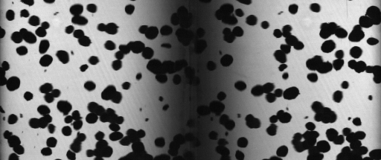
Three-dimensional collision analysis of millimeter-sized dust aggregates
R.Weidling and J. Blum, IGEP, TU Braunschweig r.weidling@tu-bs.de

Slide 2
Motivation
Bouncing
Sticking
Fragmentation
after Güttler et al., 2010

Slide 3
Motivation
no experiments at transition sticking - bouncing at that time
transition derived from theory
Bouncing
Sticking
Fragmentation
after Güttler et al., 2010

Slide 4
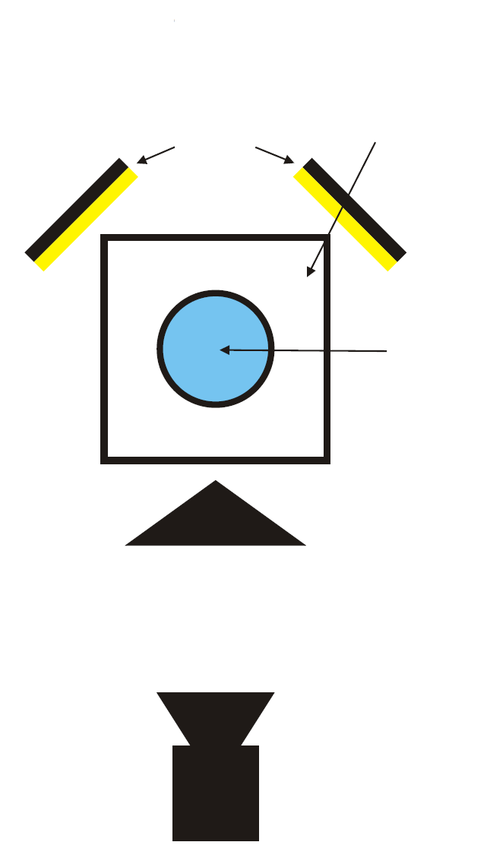
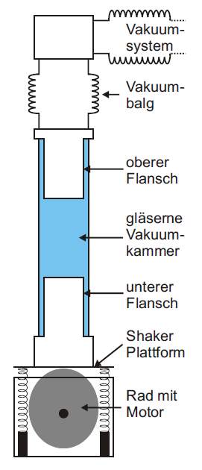
MEDEA
bellows
LED arrays
shaker
platform
upper flange
vacuum
chamber
glass vacuum
chamber
lower flange
prism
shaker platform
motorized
excentric wheel
high-speed
camera

Slide 5
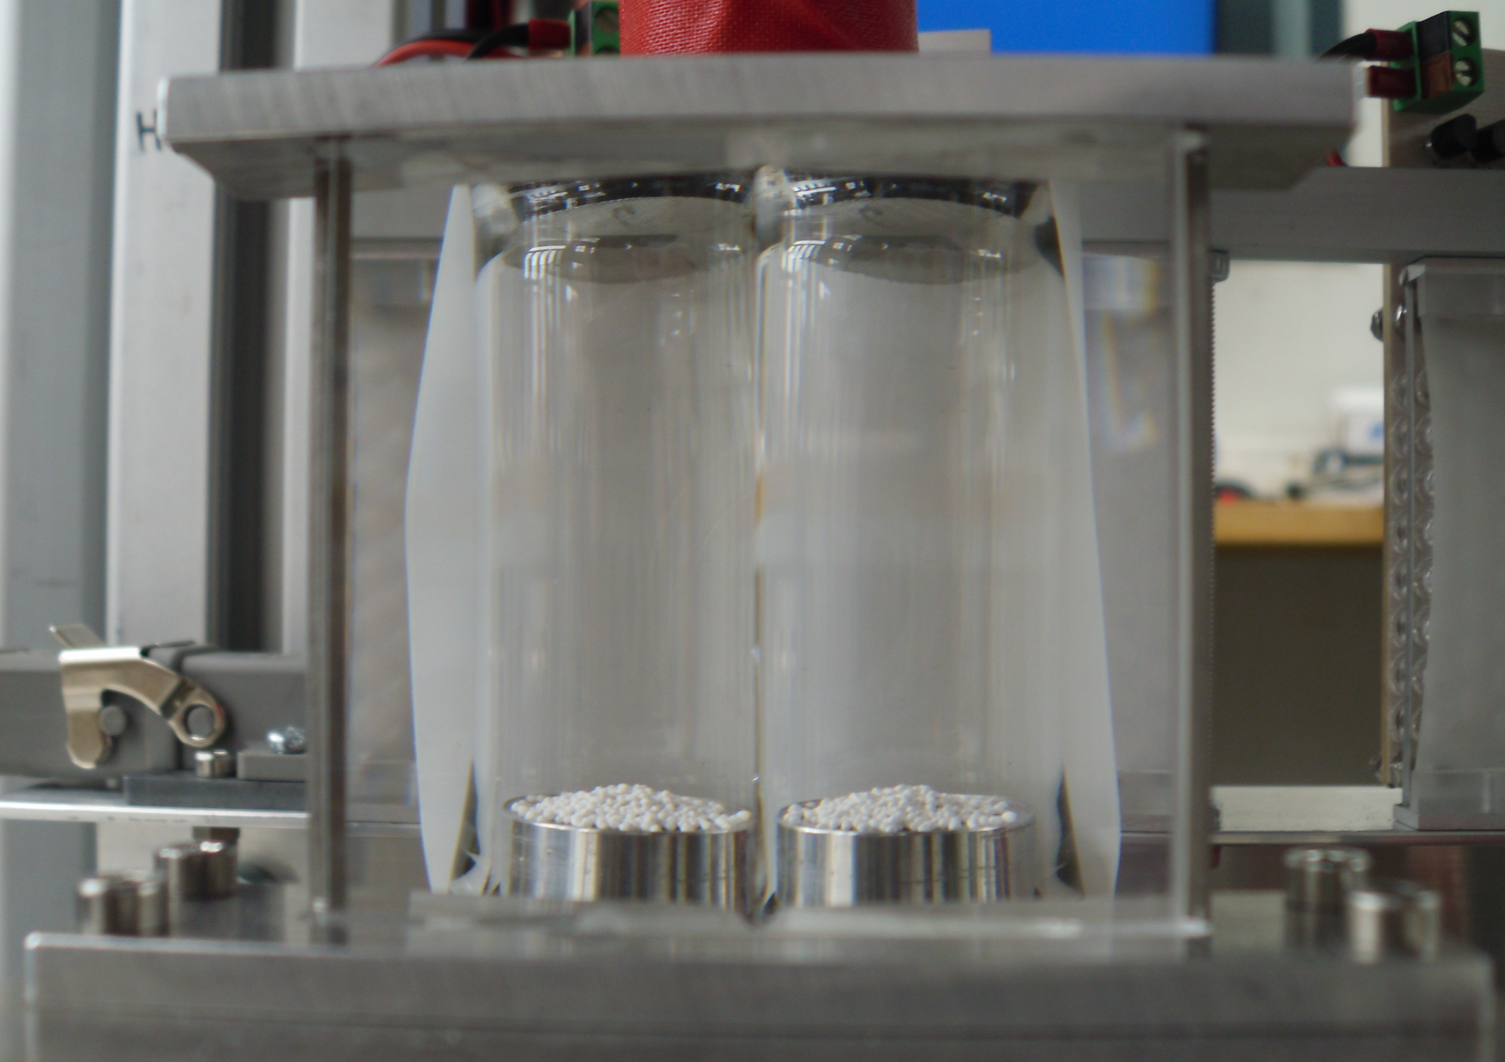
MEDEA

Slide 6
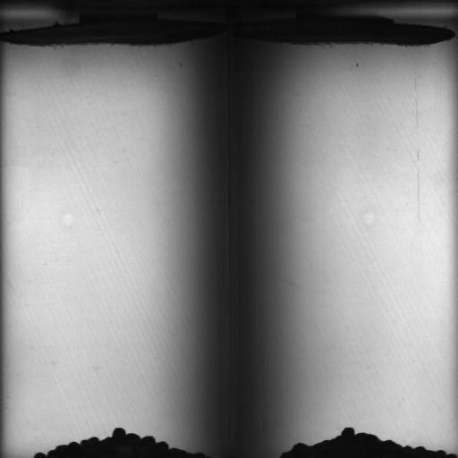
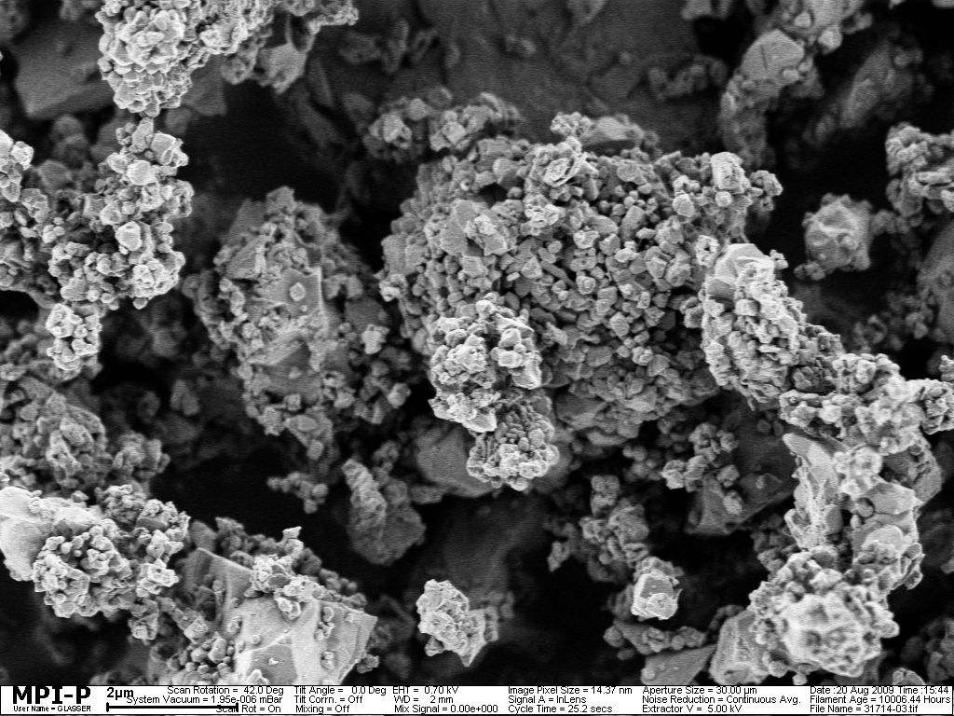
Experiment
2 µm
1-1.6 mm-sized dust aggregates made up of polydisperse SiO₂
3 shaking phases with successively decreasing frequency

Slide 7
Results
43 collisions analyzed in 3D
9 collisions analyzed in 2D
4x sticking, 48x bouncing
7 collisions of monomers with dimers (2D)
monomers bounce off dimers, but dimer survives
collision velocities : 3.4 mm/s – 62.4 mm/s

Slide 8
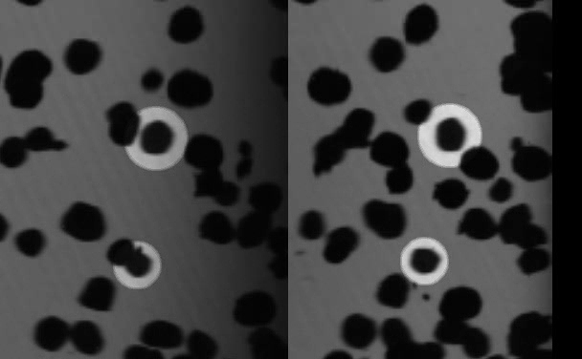
Results - Bouncing
Notes:
044066:
0,048 m/s
eps= 0,79, b/r=0,98

Slide 9
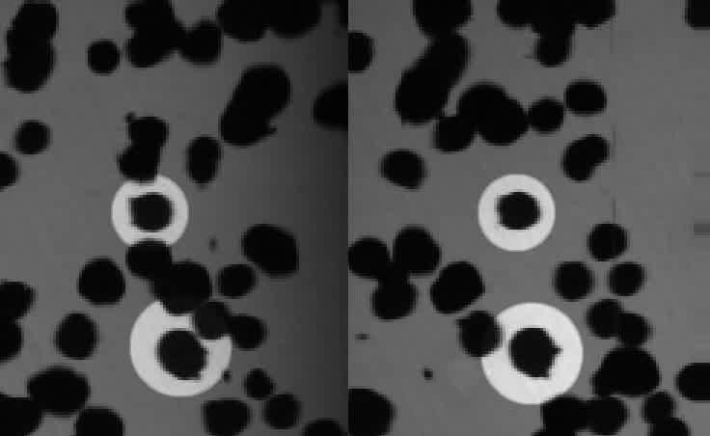
Results - Bouncing
Notes:
092118:
0,029 m/s
eps= 0,48, b/r=0,91

Slide 10
Results - Bouncing
Notes:
092118:
0,029 m/s
eps= 0,48, b/r=0,91

Slide 11
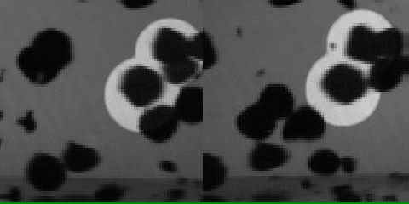
Results - Sticking

Slide 12
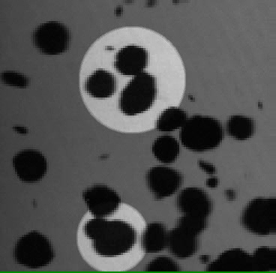
Results – Monomer vs Dimer
Notes:
0,015 m/s

Slide 13
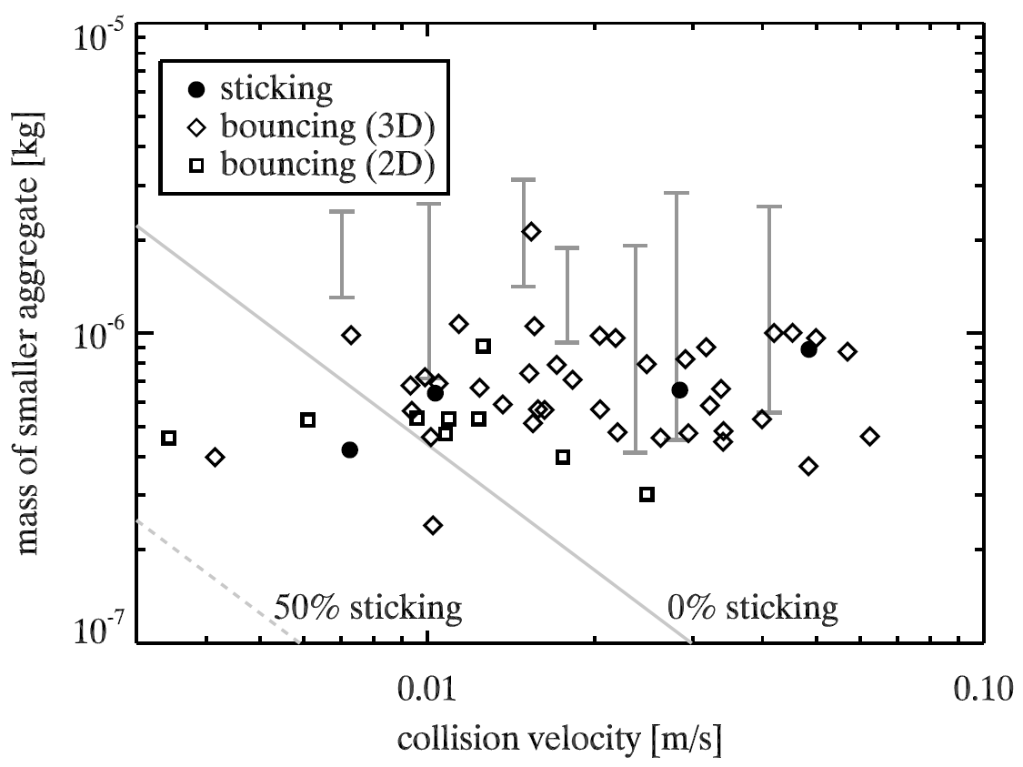
Update: Collision Model
based on Kothe et al., 2013

Slide 14
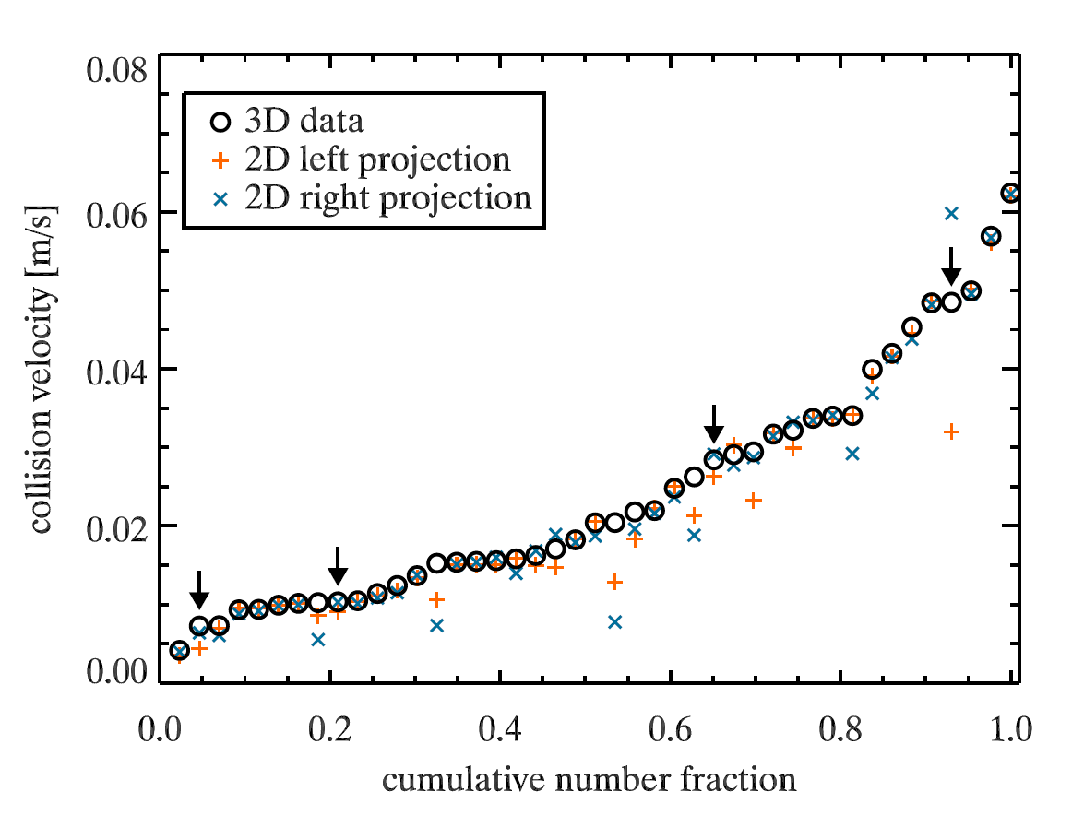
Results: 3D vs. 2D
Notes:
Geschwindigkeit in 2D i.A. sehr gut ->

Slide 15
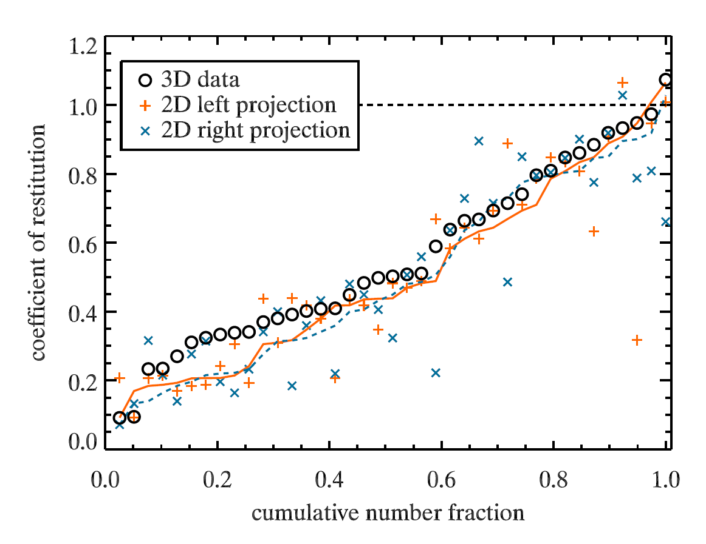
Results: 3D vs. 2D

Slide 16
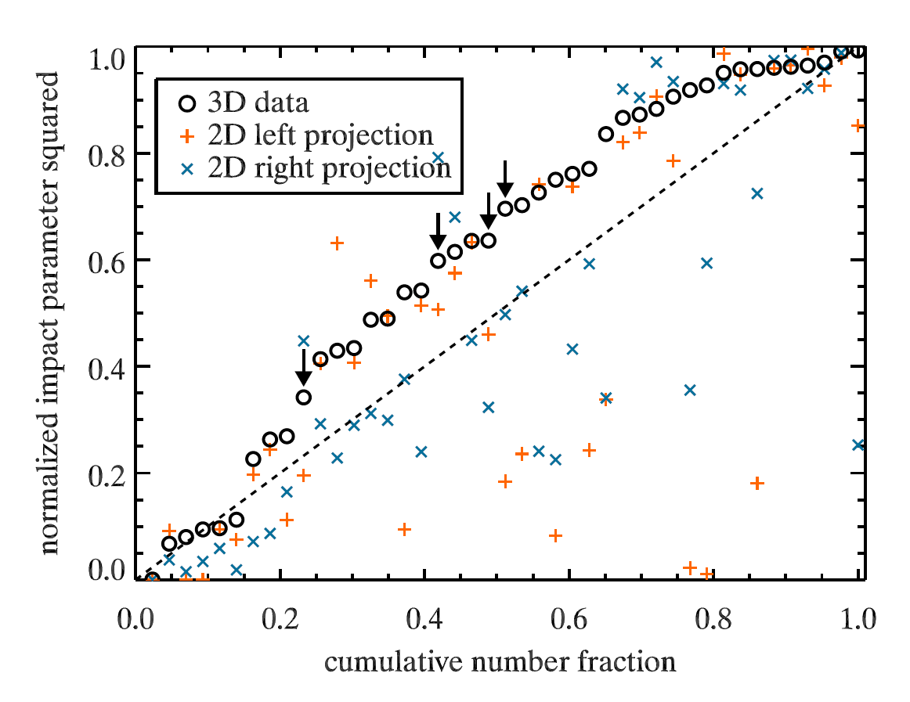
Results: 3D vs. 2D

Slide 17
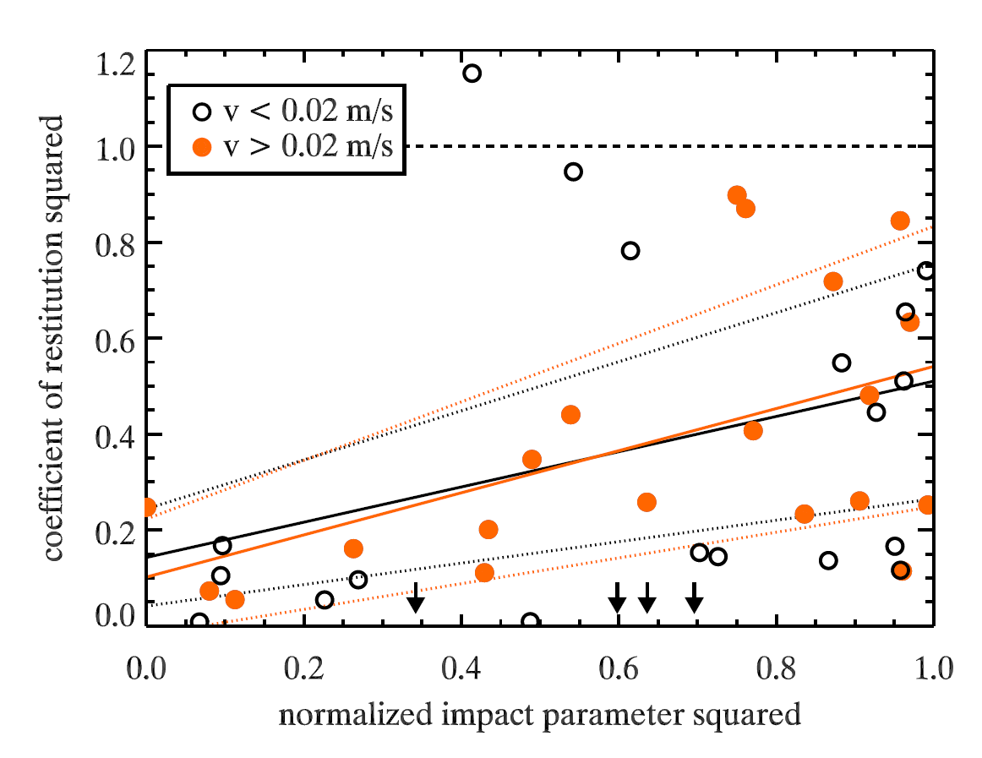
Results: 3D vs. 2D

Slide 18
Summary
2D velocity analysis sufficient (in MEDEA-type experiments)
coefficients of restitution in 2D with statistical value
3D analysis mandatory for collision parameter
collision model needs further refinement
„lucky winners“ can survive further collisions

